Slide 1
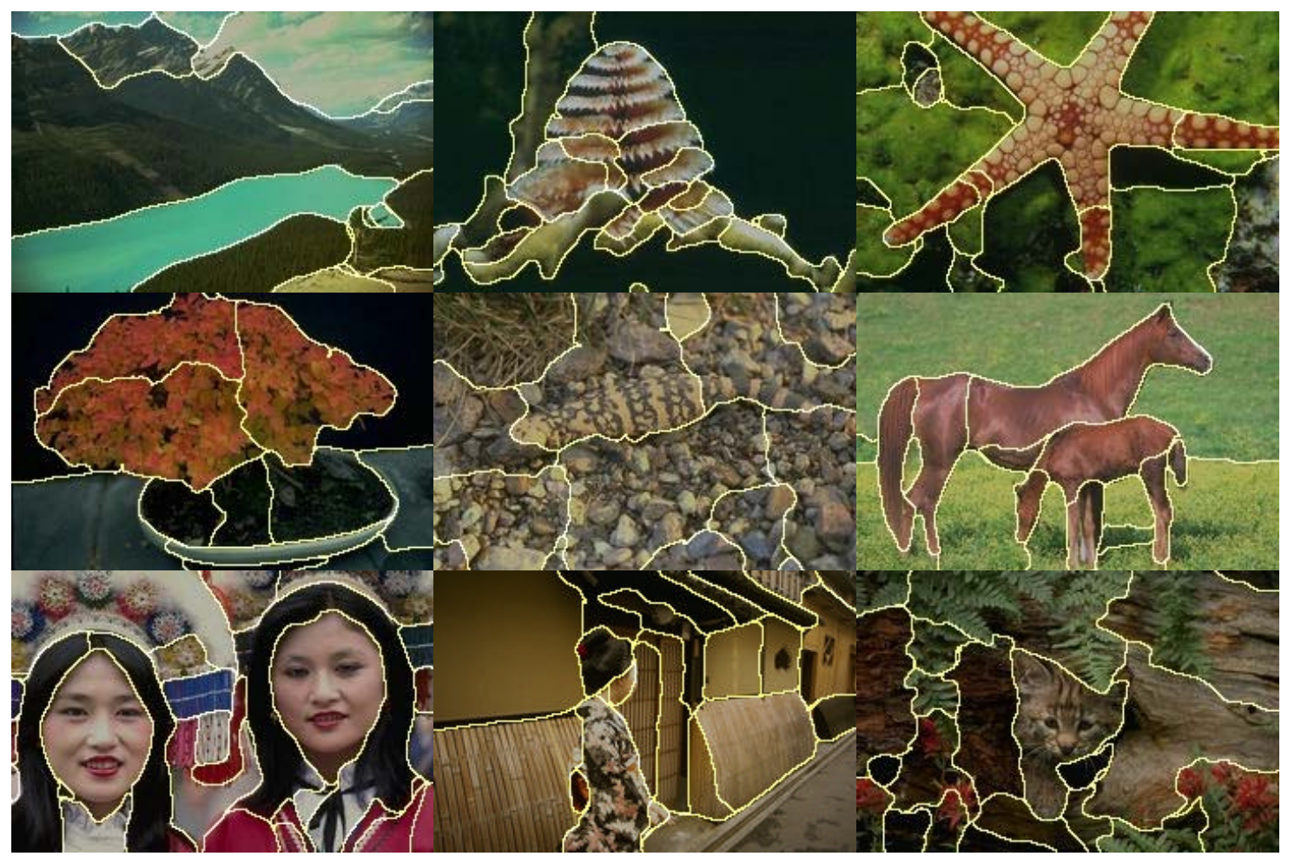
图像分割 Image Segmentation Ning Tang

Slide 2
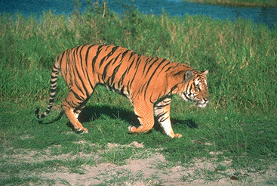
From Pixels to Perception

Slide 3
From Pixels to Perception

Slide 4
From Pixels to Perception
back
Tiger
head
eye
tail
legs
mouth
shadow

Slide 5
From Pixels to Perception
back
Tiger
head
eye
tail
legs
mouth
Water
Grass
Tiger
shadow
Sand

Slide 6

Visual Grouping
I stand at the window and see a house, trees, sky. Theoretically I might say there were 327 brightnesses and nuances of colour.
Do I have "327"?
No. I have sky, house, and trees.
---- Max Wertheimer, 1923

Slide 7
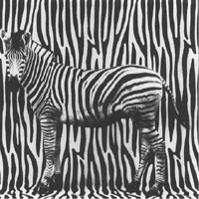
Human visual system
Computer Vision
Visual Grouping
Image Segmentation

Slide 8
Image Segmentation
Image segmentation is the process of partitioning a image into multiple regions.
More precisely, image segmentation is the process of assigning a label to every pixel in an image so that pixels with the same label share certain characteristics (such as color, intensity, or texture).

Slide 9
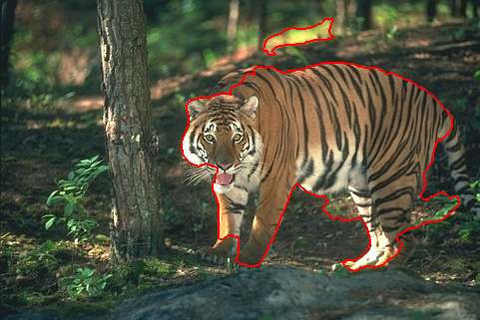
The Goal of Image Segmentation
Simplify the representation of an image into something that is more
meaningful and easier to analyze.

Slide 10
The Goal of Image Segmentation
Simplify the representation of an image into something that is more
meaningful and easier to analyze.
A pre-processing in Computer Vision

Slide 11
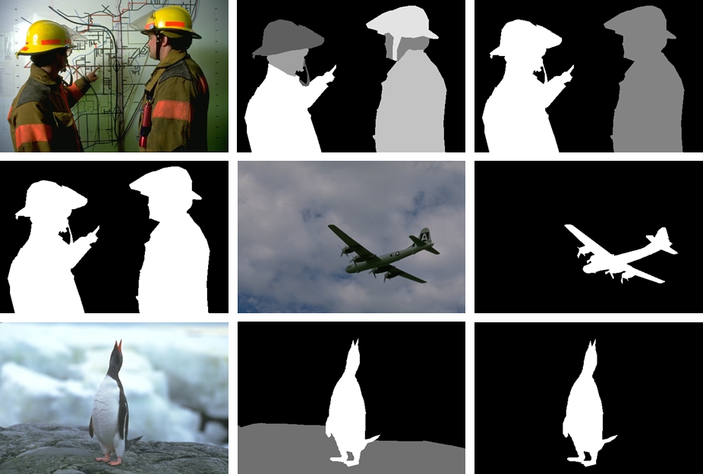
Image Segmentation Dataset
For image segmentation, we need :
original image
ground-truth

Slide 12
Compare real segmentation result with ground-truth
real segmentation
result
ground-truth

Slide 13
Manual annotation for getting ground-truth
original image
human
labeling
ground-truth

Slide 14
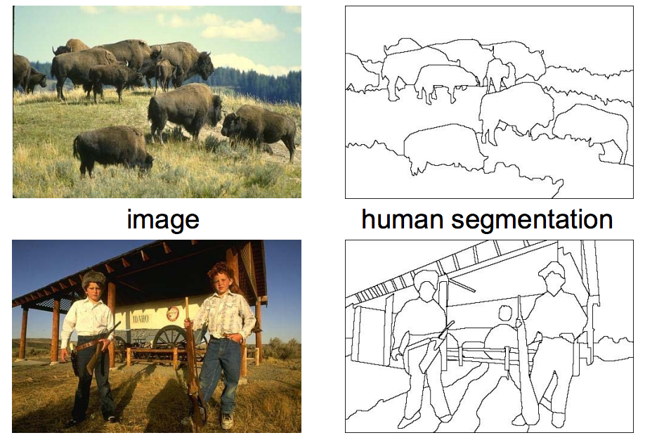
Some Common Datasets in Image Segmentation
BSDS500：
The dataset consists of 500 natural images (train, validation and
test subsets) and ground-truth human annotations.
BSDS dataset:
https://www2.eecs.berkeley.edu/Research/Projects/CS/vision/grouping/resources.html

Slide 15
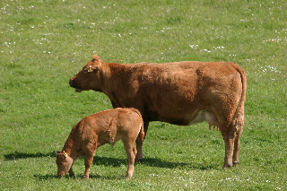
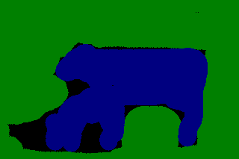
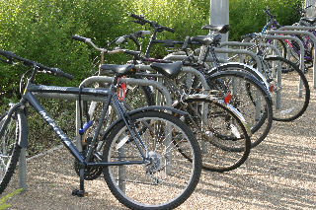

Some Common Datasets in Image Segmentation
MSRC：
The dataset consists of 591 natural images and ground-truth human
annotations.
image
human segmentation
MSRC dataset:
https://www.microsoft.com/en-us/research/project/image-understanding/

Slide 16
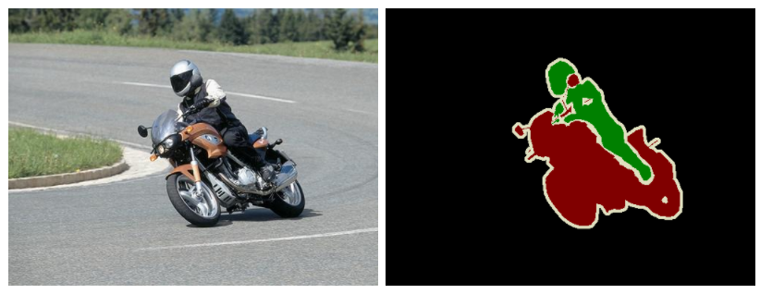
Some Common Datasets in Image Segmentation
PASCAL VOC2012：
The dataset consists of almost 10K natural images and ground-truth
human annotations.
image
human segmentation
PASCAL dataset:
http://host.robots.ox.ac.uk/pascal/VOC/voc2012/

Slide 17
Image Segmentation Methods
Threshold Based Segmentation
Edge Based Segmentation
Region Based Segmentation
Active Contour Based Segmentation
Graph Based Segmentation
… …

Slide 18
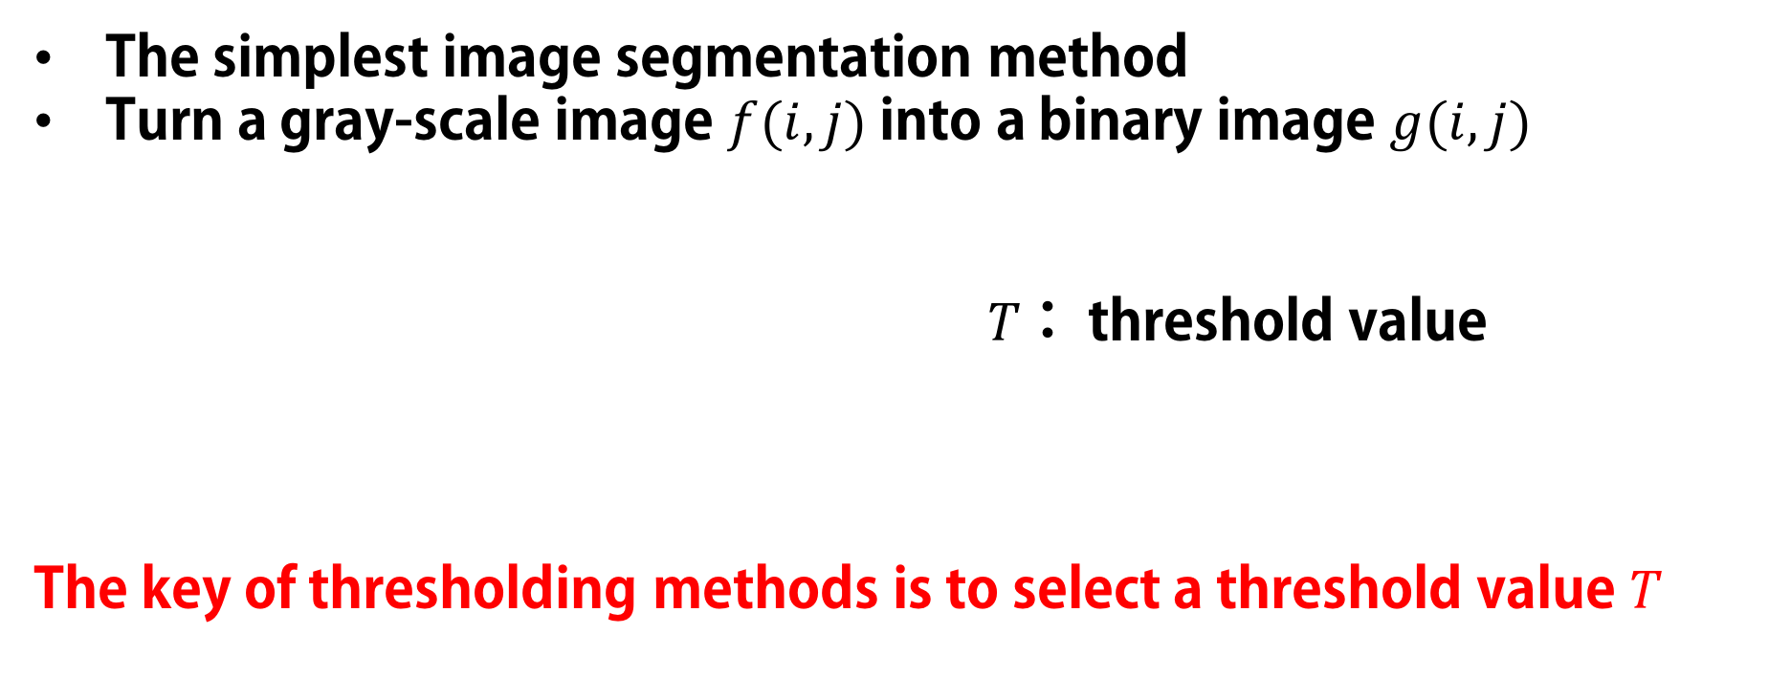
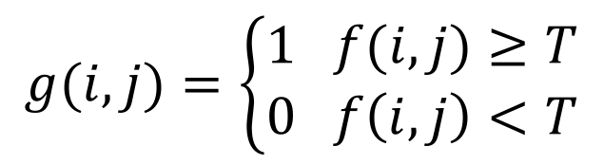
Threshold Based Segmentation
The simplest image segmentation method
Turn a gray-scale image $f(i,j)$into a binary image $g(i,j)$
$T$： threshold value
The key of thresholding methods is to select a threshold value $T$
$$g(i,j)=\left\{\begin{aligned}1 f(i,j)≥T \\ 0 f\left(i,j\right)<T\end{aligned}\right.$$

Slide 19
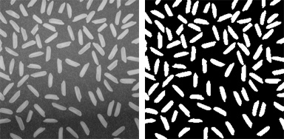
Otsu Thresholding
Select the best threshold value to maximize the difference between background and target (maximize the inter-class variance)
Global thresholding method

Slide 20
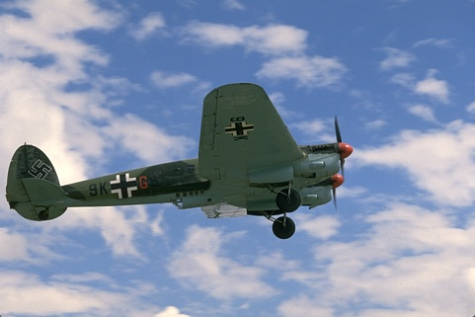
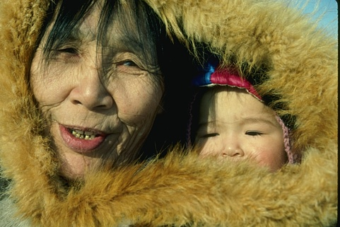
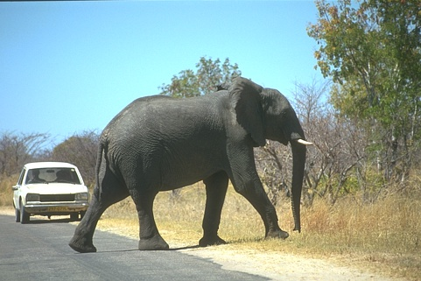

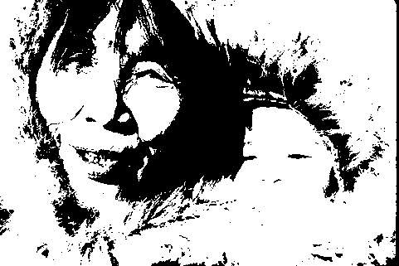
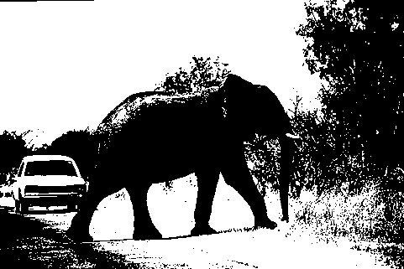
some images in BSDS500
otsu

Slide 21
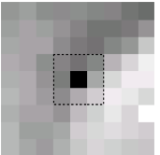

Adaptive Thresholding
Finding the local threshold is to statistically examine the intensity values of the local neighborhood of each pixel
Local thresholding method
a pixel and its $3×3$neighborhood

Slide 22
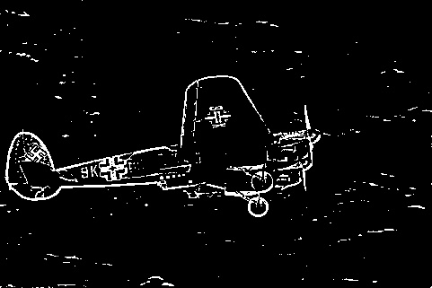
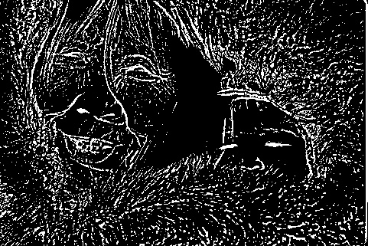
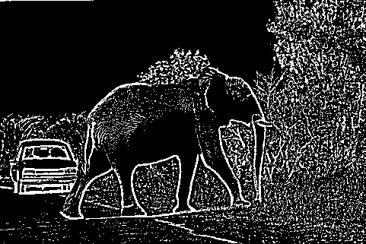
images in BSDS500
adaptive
more local details

Slide 23
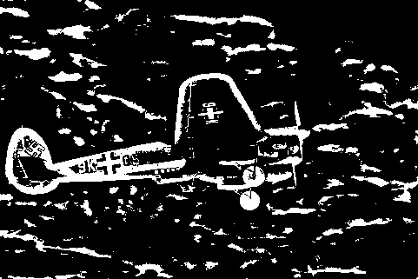
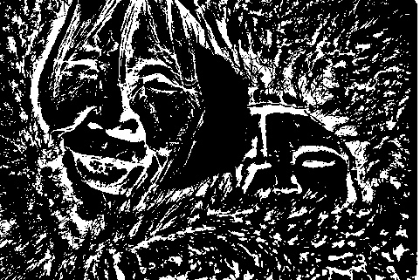
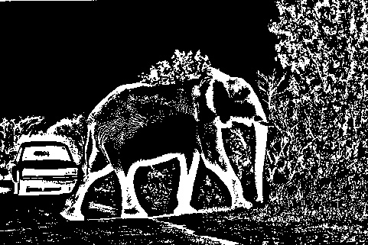
images in BSDS500
adaptive
more local details
in larger
neighborhood

Slide 24
About Thresholding Methods
Advantages:
Simplicity of calculation, fast
Disadvantages:
Only consider gray-scale information
Sensitive to noise

Slide 25

What is the edge?
An edge is the boundary between two regions with distinct properties (color, intensity, or texture).

Slide 26
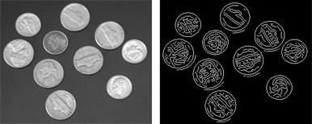
Edge Based Segmentation
Edges are important features in a image to separate regions
Based on discontinuity
Edge detection is the principal approaches to image segmentation

Slide 27
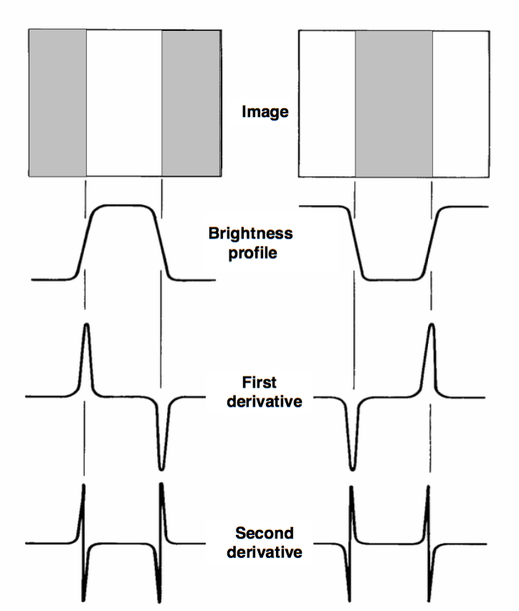
What is edge detection?

Slide 28
What is edge detection?
Edge detection by means of gradient operators

Slide 29
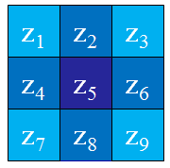
How gradient operators work?
image
＊ ＝
edge image
gradient mask

Slide 30
Common Gradient Masks
First order gradient masks :
Sobel
Roberts
Prewitt
... ...
Second order gradient masks :
Canny
LoG（Laplacian-Gauss）
... ...

Slide 31
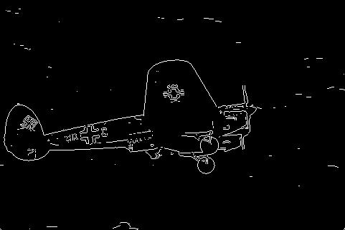
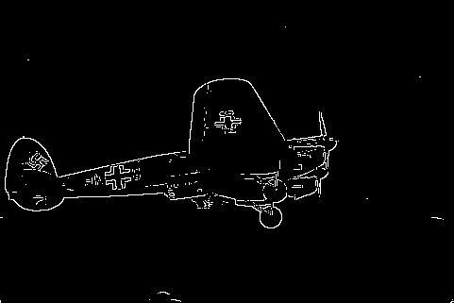
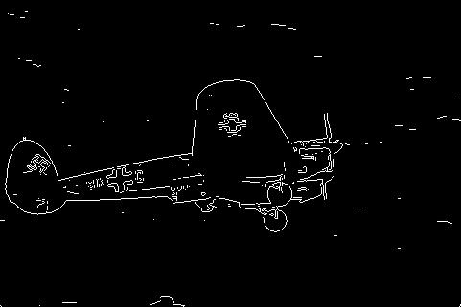
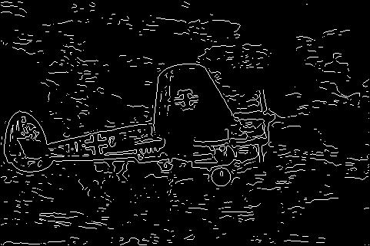
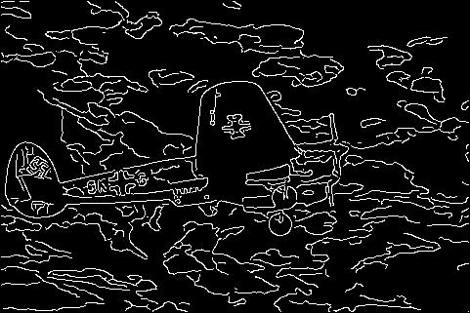
Sobel
Roberts
Prewitt
image
LoG
Canny

Slide 32
The Problem of Edge Detection
Noise and background affect the accurate of edge detection
Edge presence in locations where there is no border, but no edge presence where a real border exists.
Edges are the sign of lack of continuity, and ending.

Slide 33
The edges produced by edge detection can not be used directly,
because edges are discontinuous.
input
Edge Detection
Edge Linking
Segmentation Result

Slide 34
From Edge to Region
The simplest way is some Morphological operations to fill the edge

Slide 35
About Edge Based Segmentation Methods
Advantages:
Simplicity of calculation, fast
Works well in images with good contrast between object and background
Disadvantages:
Does not work well on images with smooth transitions and low contrast
Sensitive to noise

Slide 36
What is a region?
A group of connected pixels with similar properties

Slide 37
Region Based Segmentation
Region is an important concept because regions may correspond
to objects in a scene
Based on similarity
Those pixels that correspond to an object are grouped together
and marked
Region based segmentation is a technique that allows us to
determine the regions directly

Slide 38
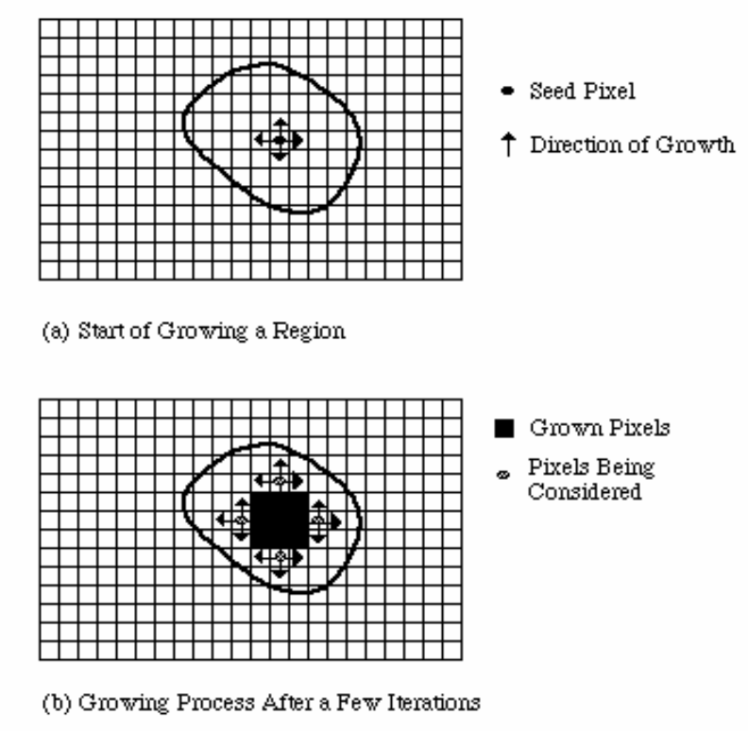
Region Growing Segmentation
Start from some seed points to represent the property we want, then grow the region
A bottom up method

Slide 39
Region Growing Segmentation
Start from some seed points to represent the property we want, then grow the region
A bottom up method

Slide 40
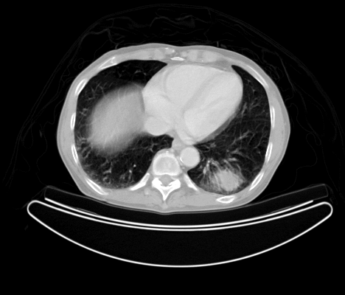

An Example of Region Growing
set a seed around here
image
result

Slide 41
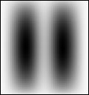
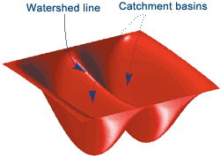
Watershed Segmentation
An image is considered as a 3D topographic surface with valleys
and mountains

Slide 42
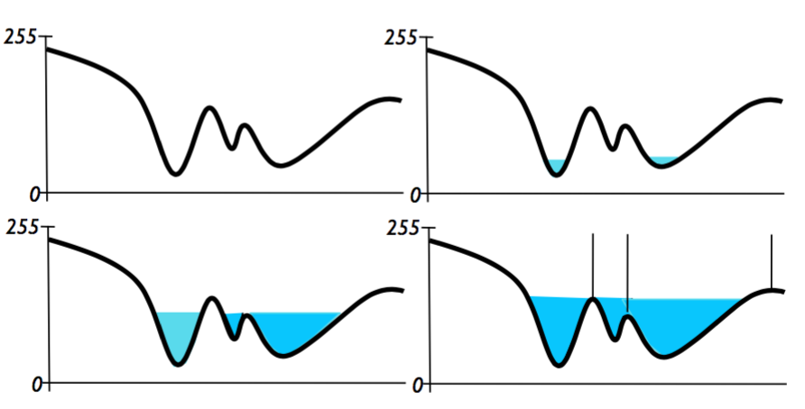
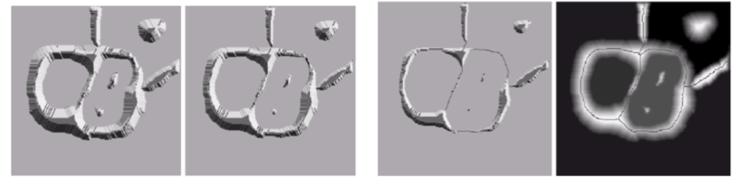
Watershed Segmentation
The goal of watershed
segmentation:
To find the watershed lines
Watershed lines are remained by flooding water

Slide 43
Watershed Segmentation
The difficulty of watershed segmentation is determining the masks as flooding water

Slide 44
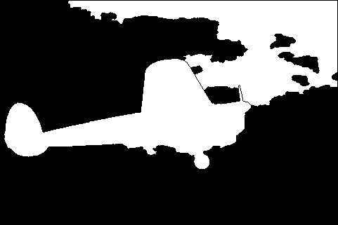
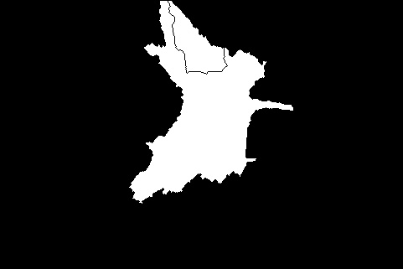

image
watershed

Slide 45
image
watershed
over-segmentation

Slide 46
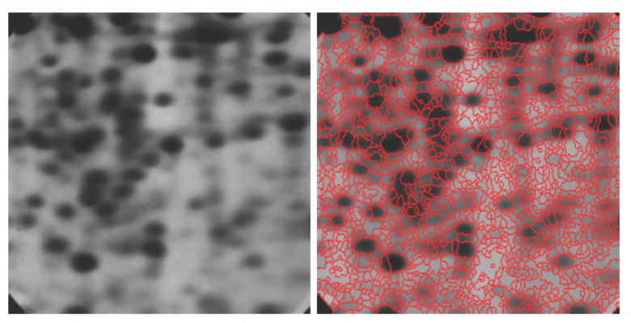
Over-segmentation
A division into too many segments, as when attempting to
recognize parts of an image.

Slide 47
About Region Based Segmentation Methods
Advantages:
Simplicity of calculation, fast
Disadvantages:
These two region based segmentation methods need human marks
Sensitive to noise
Watershed segmentation usually causes over-segmentation phenomenon

Slide 48
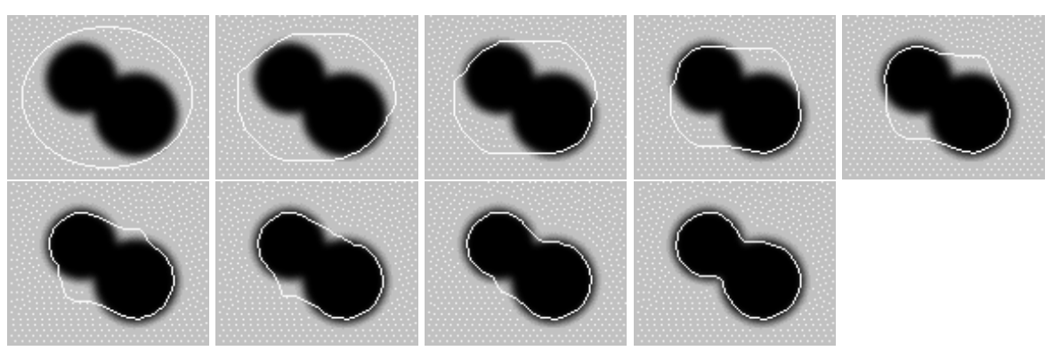
Active Contour Based Segmentation
Start from a contour
Snake, Level set

Slide 49
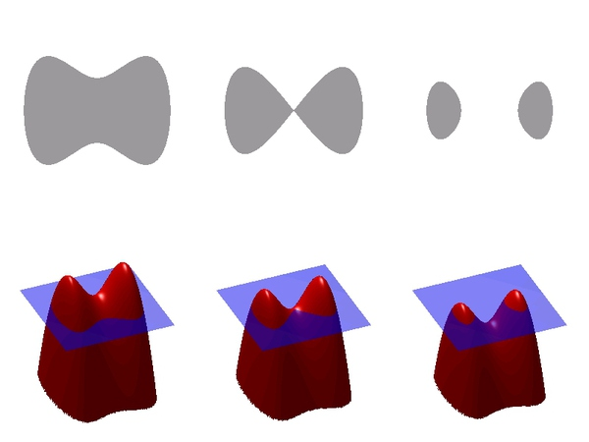
Level Set Segmentation

Slide 50
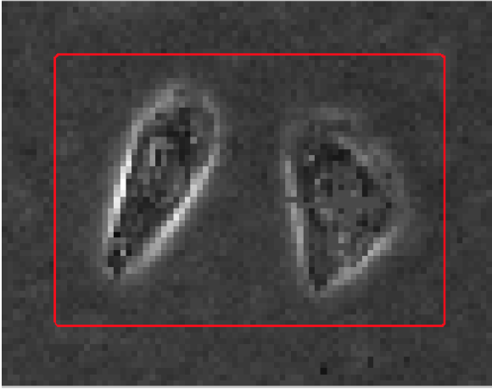
An Example of Level Set Segmentation

Slide 51
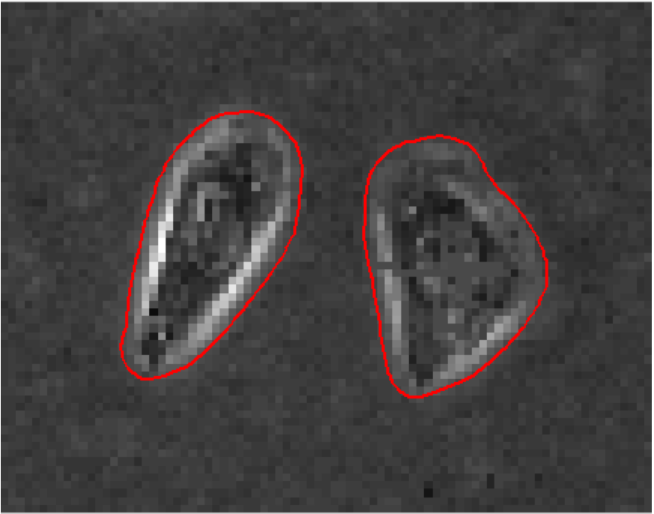
An Example of Level Set Segmentation

Slide 52
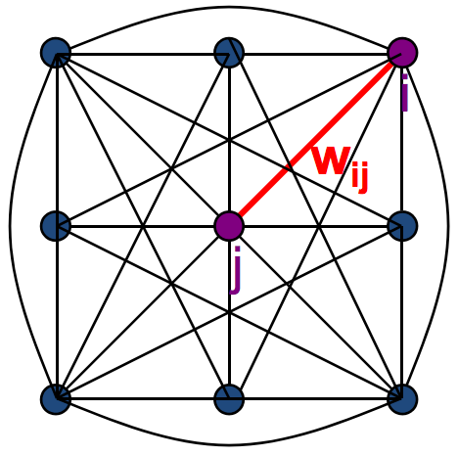
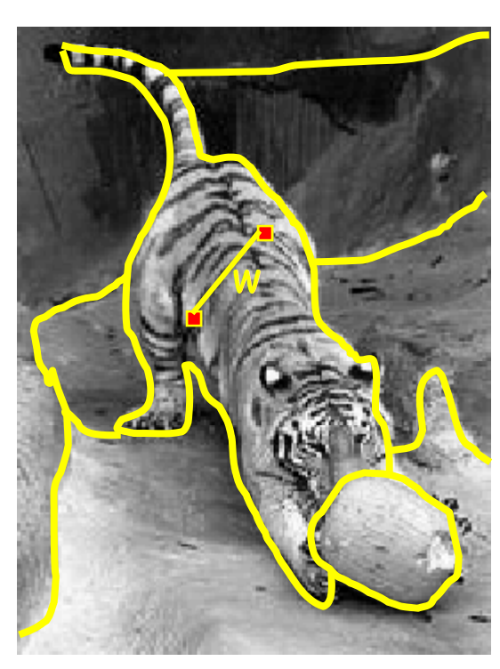
Graph Based Segmentation
Images as Graphs : G = {V,E}
V (Vertex): graph nodes Image = { pixels }
E (Edge): edges connection nodes Pixel similarity

Slide 53
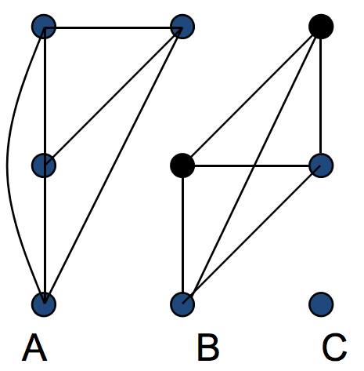
Break Graph into segments
Delete links that cross between segments
Easiest to break links that have low cost (low similarity)

Slide 54
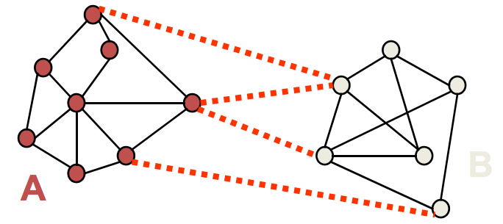

Cuts in a Graph
Link Cut
set of links whose removal makes a graph disconnected
cost of a cut:
$$cut\left(A,B\right)=\sum_{u∈A,v∈B}{w_{uv}}$$
One idea: find minimum Cut (Min Cut)

Slide 55


Two Interactive Min Cut Based Segmentation Methods
Graph Cuts
Grab Cuts

Slide 56

But Min Cut is not always the best Cut

Slide 57


Normalized Cuts
• A cut penalizes large segments
• Fix by normalizing for size of segments
• assoc(A,V) = sum of costs of all edges that touch A
$$Ncut\left(A,B\right)=\frac{cut(A,B)}{assoc(A,V)}+\frac{cut(A,B)}{assoc(B,V)}$$
$$cut\left(A,B\right)=\sum_{u∈A,v∈B}{w_{uv}}$$
“Normalized Cuts and Image Segmentation”, JianBo Shi and Jitendra Malik, PAMI, 2000

Slide 58

Normalized Cuts
• A cut penalizes large segments
• Fix by normalizing for size of segments
• assoc(A,V) = sum of costs of all edges that touch A
$$Ncut\left(A,B\right)=\frac{cut(A,B)}{assoc(A,V)}+\frac{cut(A,B)}{assoc(B,V)}$$
$$cut\left(A,B\right)=\sum_{u∈A,v∈B}{w_{uv}}$$
$minNcut\left(A,B\right)$ is NP－Hard
“Normalized Cuts and Image Segmentation”, JianBo Shi and Jitendra Malik. PAMI, 2000

Slide 59




Solution
$$minNcut\left(A,B\right)$$
Solve for eigenvectors with the smallest eigenvalues:
approximation
$$\left(D−W\right)y=λDy$$
$$D=\left[\begin{matrix}\sum_{j}{w(1,j)} & ⋯ & 0 \\ ⋮ & ⋱ & ⋮ \\ 0 & ⋯ & \sum_{j}{w(N,j)}\end{matrix}\right]$$
$$W=\left[\begin{matrix}w(1,1) & ⋯ & w(1,N) \\ ⋮ & ⋱ & ⋮ \\ w(N,1) & ⋯ & w(N,N)\end{matrix}\right]$$

Slide 60

Solution
$$\left(D−W\right)y=λDy$$
Use the eigenvector with the second smallest eigenvalue to bipartition the graph
Recursively repartition the segmented parts if necessary

Slide 61









Some Normalized Cuts Results
need to set the number of segments (K)

Slide 62
Some Normalized Cuts Results
need to set the number of segments (K)
here, K=10

Slide 63
About Normalized Cuts
Advantages:
Generic framework, can be used with many different features and affinity formulations
Disadvantages:
Need to chose number of segments
High storage requirement and time complexity

Slide 64



Efficient Graph-Based Image Segmentation
Predicate D determines whether there is a boundary for segmentation
$$D\left(C_{1},C_{2}\right)=\left\{\begin{aligned}true ifDif\left(C_{1},C_{2}\right)>MInt\left(C_{1},C_{2}\right) \\ \end{aligned}\right.$$
false otherwise
Where
$Dif\left(C_{1},C_{2}\right)$is the difference between two components
$MInt\left(C_{1},C_{2}\right)$is the minimum internal different in the components $C_{1}$and $C_{2}$
“Efficient Graph-Based Image Segmentation”, P. Felzenszwalb and D. Huttenlocher, IJCV, 2004

Slide 65




Efficient Graph-Based Image Segmentation Results
Need to tune parameters by hand

Slide 66

Mean Shift
A feature space analysis method
Built on probabilistic intuitions
“Mean shift: a robust approach toward feature space analysis”, D. Comaniciu and P. Meer, PAMI, 2002

Slide 67

Non-Parametric Methods
Basic Idea: Use the data to define the distribution
Kernel-density estimates

Slide 68
What is Mean-Shift?
The density will have peaks (also called modes)
If we started at point and did gradient-ascent, we would end up at one of the modes
Cluster based on which mode each point belongs to

Slide 69
Gradient Ascent?
Actually, no
A set of iterative steps can be taken that will monotonically converge to a mode
– No worries about step sizes – This is an adaptive gradient ascent

Slide 70

Mean Shift Result
image
result

Slide 71



gPb-owt-ucm
Image
Contour
Segmentation

Slide 72
Contour Detection
Learn local boundary cues
Global framework to capture closure, continuity
Local cues and global cues combination

Slide 73

Learn Local Boundary Cues
Image
Local Boundary Cues
Brightness
Cue Combination
Model
Color
Texture
$$mPb\left(x,y,θ\right)=\sum_{s}{\sum_{i}{α_{i,s}G_{i,σ\left(i,s\right)}(x,y,θ)}}$$

Slide 74



Global framework
Build a weighted graph G=(V,E) from image

Slide 75

Local cues and global cues combination
$$gPb\left(x,y,θ\right)=\sum_{s}{\sum_{i}{β_{i,s}G_{i,σ\left(i,s\right)}\left(x,y,θ\right)+γ∙sPb(x,y,θ)}}$$
Local Cues
Global Cues

Slide 76
Hierarchical Segmentation
Oriented Watershed Transform
Ultrametric Contour Map

Slide 77


Watershed Transform
Image
Watershed

Slide 78

Oriented Watershed Transform

Slide 79

Ultrametric Contour Map
Iterative Merging

Slide 80






Some gPb-owt-ucm Results

Slide 81









Slide 82
Thanks

